Slide 1



Healthcare Scenario - Healthy Living and Wellness Clustering
Exploring unsupervised learning to identify patient wellness patterns for personalized healthcare interventions.
by Priyal Rawat
Notes:
This study explores how unsupervised machine learning techniques can help healthcare organizations better understand and support patient wellness.

Slide 2

Introduction
Modern Healthcare Challenge
Health and wellness optimization remains a critical focus in contemporary healthcare systems.
Core Problem
Healthcare providers struggle to understand diverse patient health patterns effectively.
Approach
Apply unsupervised learning algorithms to identify meaningful patient wellness clusters.
Notes:
Healthcare and wellness have become increasingly important in today’s world. While many organizations offer wellness programs, they often apply generic strategies that don't account for individual differences. The goal of this study was to use unsupervised learning techniques to discover meaningful clusters or groups within a patient population—based on lifestyle factors like diet, exercise, sleep, and stress—to enable more personalized health interventions

Slide 3
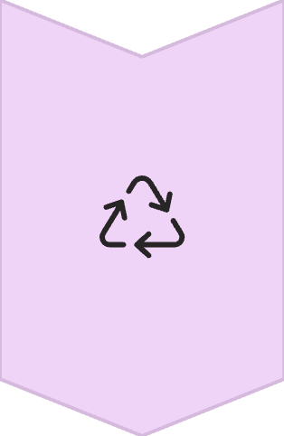
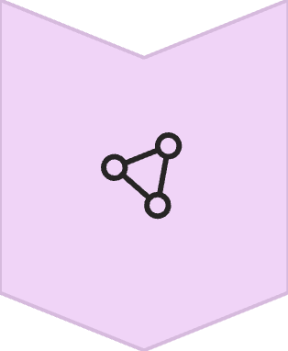

Problem Statement
Healthcare organizations face significant challenges with wellness program design.
One-Size-Fits-All
Traditional approaches fail to account for individual differences in:
Generic wellness programs with limited effectiveness
Lifestyle patterns
Patient Segmentation
Stress management
Behavior-based clustering to identify patterns
Dietary habits
Sleep behaviors
Personalized Care
Targeted wellness interventions for optimal impact
Notes:
Healthcare organizations struggle to design effective wellness programs due to the diverse and complex nature of individual health behaviors. Generic solutions fail to adapt to the varied needs of patients, resulting in low engagement and poor outcomes. There’s a clear gap in identifying patterns within patient wellness data that can inform targeted care. Addressing this lack of behavioral segmentation is essential to improving overall program success and patient well-being.

Slide 4
Literature Insights & Research Gap
Key Research Findings
Our Contribution
Alanazi (2022)
1
Filling the gap in wellness-based patient segmentation
Comparing multiple clustering models with PCA integration
Machine learning can detect wellness patterns to address healthcare inefficiencies.
Evaluating cluster performance for personalized wellness strategies
2
Trezza et al. (2024)
Unsupervised learning enables precision medicine through distinct patient profiling.
Lu & Uddin (2024)
3
PCA enhances clustering interpretability and improves model performance.
Notes:
Most wellness programs fail to consider that not all patients are the same. This leads to a ‘one-size-fits-all’ approach, which can reduce program effectiveness. Literature shows that machine learning can reveal hidden patterns—Alanazi (2022) highlighted the role of ML in identifying inefficiencies, while Trezza et al. (2024) and Lu & Uddin (2024) supported the use of unsupervised learning and PCA for improved segmentation. However, this research is insipired by our study but this research primarily focus on concentrated status with the dataset which include lifestyle parameters so it can give us insight into patients day to day behaviour and then we can apply tailored wellness programs.

Slide 5





Dataset Overview
Our analysis uses a simulated healthcare dataset containing key wellness indicators.
Exercise Time
Healthy Meals
Sleep Hours
Minutes spent exercising daily
Number of nutritious meals consumed per day
Average hours of sleep per night
Stress Level
BMI
Self-reported stress measurement scale
Body Mass Index calculation
Notes:
I worked with a simulated healthcare dataset. It included five key wellness indicators: daily exercise duration, number of healthy meals, hours of sleep, self-reported stress level, and BMI. We found no missing data, which ensured consistency for our analysis.

Slide 6
Dataset Preprocessing & Standardization
Checked for nulls (none found)
Standardized using Z-score normalization (mean=0, std=1)
Reason: To ensure equal contribution to clustering algorithms
 | Exercise_Time_Min | Healthy_Meals_Per_Day | Sleep_Hours_Per_Night | Stress_Level | BMI
0 | 0.578767 | 1.173447 | 0.482957 | -1.152351 | 1.565523
1 | -0.104981 | 2.830078 | -1.993156 | 0.771441 | 0.418669
2 | 0.741336 | 0.621237 | -0.640956 | -1.53711 | -0.27101
3 | 1.683908 | -1.035394 | 1.149993 | 1.156199 | 0.923359
4 | -0.208235 | 0.069026 | 0.964166 | -0.767593 | 1.146154
Notes:
Before applying machine learning models, we standardized the data using Z-score normalization. This step made sure all features had equal weight—essential for distance-based clustering algorithms like K-Means. This transformation rescaled the features to have a mean of 0 and a standard deviation of 1. This helped us avoid bias toward variables with larger scales.

Slide 7
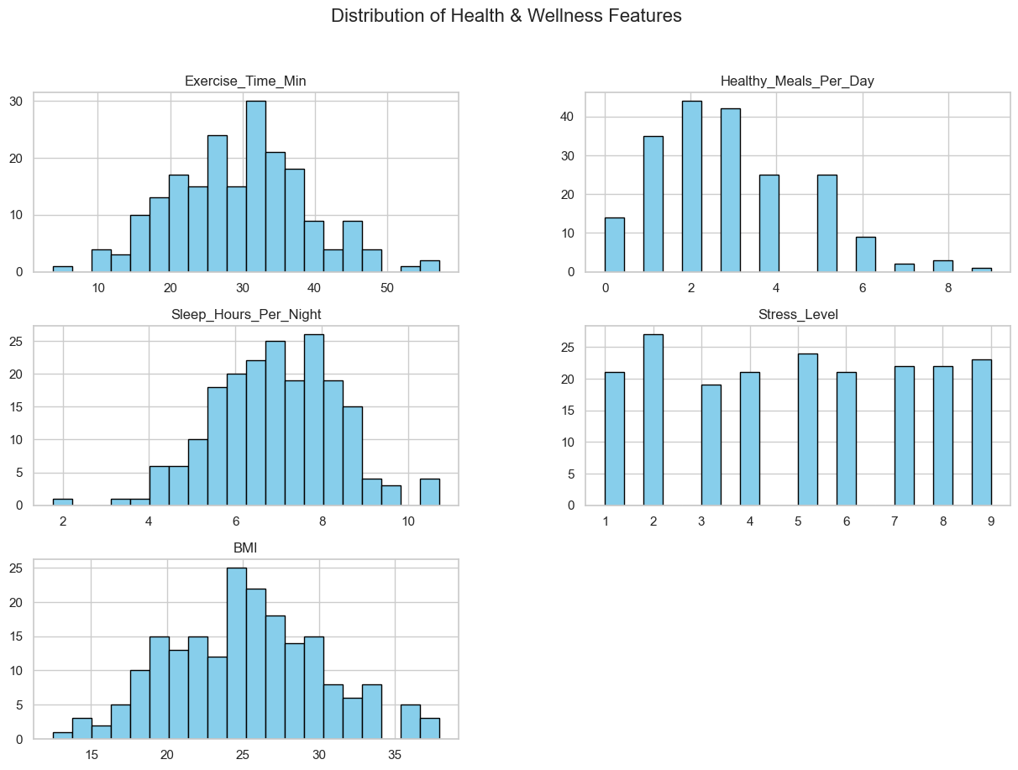
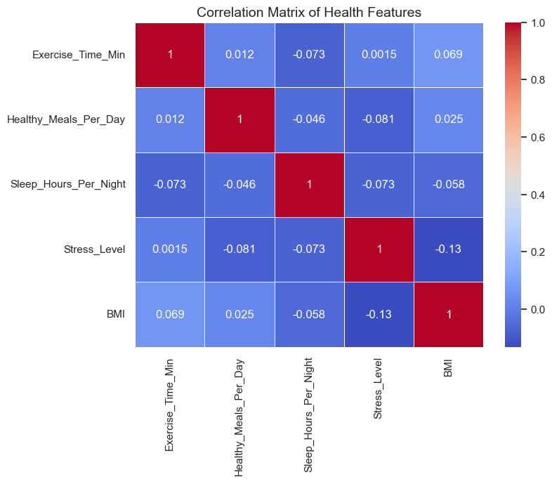
Exploratory Data Analysis
Figure 1 Distribution of Features
Figure 2 Correlation Heatmap
Note: This figure illustrates the distribution of all five wellness indicators across the 200 patients in the dataset. Exercise time, sleep hours, and BMI show approx normal distributions, while healthy meals is right-skewed. Stress level is uniformly distributed.
Note: This heatmap displays Pearson correlation coefficients among the five wellness variables. Most correlations are weak, with the strongest negative association observed between stress level and BMI (r = –0.13).
Notes:
We visualized the data using violin plots, swarm plots, and a correlation heatmap. Most variables followed a near-normal distribution. Interestingly, we found weak correlations—such as a slight negative correlation between stress and BMI—suggesting that each wellness dimension might vary independently across patients.

Slide 8
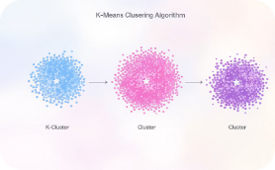
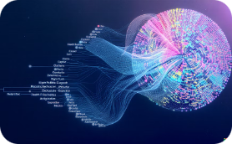
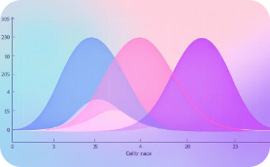
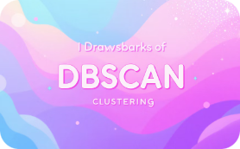
Unsupervised Learning Techniques
Multiple clustering techniques to identify distinct patient wellness profiles.
K-Means
Hierarchical
GMM
DBSCAN
Partitioned data into k clusters based on centroid proximity.
Built nested clusters by merging or splitting groups.
Modeled clusters as Gaussian probability distributions.
Failed to form meaningful clusters with our dataset.
Notes:
We tested four clustering algorithms: K-Means, Hierarchical Clustering, Gaussian Mixture Model, and DBSCAN. DBSCAN didn’t form meaningful clusters with our data even after tuning, so we focused on the other three techniques to identify distinct wellness profiles.

Slide 9
Baseline Model Results
Model
Silhouette
Within-cluster sum of squares
Davies-Bouldin
Calinski-Harabasz
K-Means
0.164
740.4663
1.5233
31.4798
Hierarchical Clustering
0.1276
760.6833
1.7066
28.1646
Gaussian Mixture Models
0.1319
759.8581
1.6362
27.8838
Initial results show modest performance. K-Means leads with highest silhouette score and Calinski-Harabasz index.
Notes:
The model has been evaluated on the basis of four parameters – Silhouette, WCSS, DB & CH. Without PCA, K-Means performed slightly better than the other models with a silhouette score of 0.164 and the lowest within-cluster sum of squares (WCSS = 740.47). However, all models showed room for improvement in terms of cohesion and separation

Slide 10
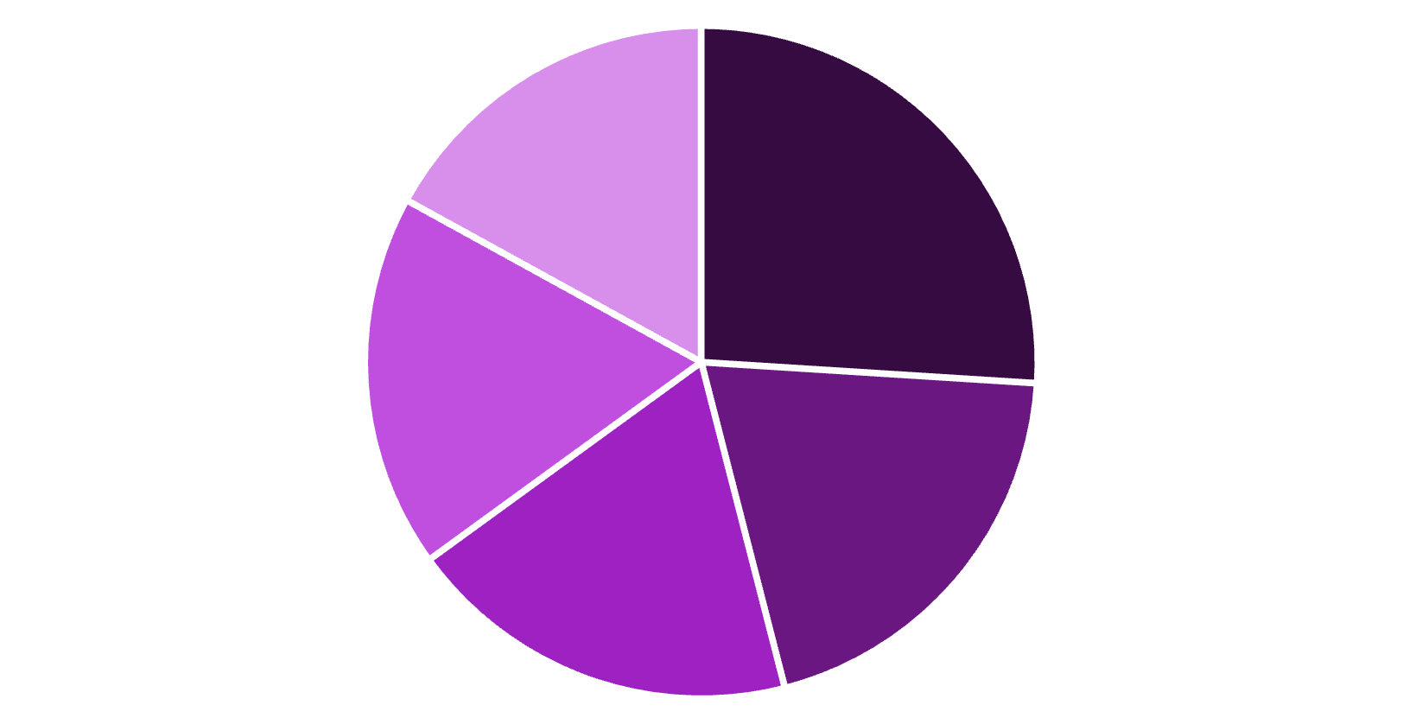
Dimensionality Reduction (PCA)
PCA Benefits
Simplified feature space
Removed data redundancy
Enhanced visualization capabilities
Improved clustering performance
PC1
PC2
PC3
PC4
PC5
PC1 and PC2 together explain approximately 46% of total variance.
Notes:
Principal Component Analysis (PCA) is a dimensionality reduction technique used in data analysis and machine learning to simplify large datasets by transforming them into fewer variables (called principal components) without losing much information. To enhance cluster quality, we applied Principal Component Analysis. PCA reduced the dataset into five components while preserving 100% of the variance. The first two components alone captured about 46%, allowing for improved visualization and reduced noise.

Slide 11
Model Results (After PCA)
Model
Silhouette
Within-cluster sum of squares
Davies-Bouldin
Calinski-Harabasz
K-Means
0.3347
412.78
0.9527
143.2028
Hierarchical Clustering
0.322
417.9697
0.9492
124.6552
Gaussian Mixture Models
0.3258
449.8469
0.9966
139.6411
K-Means achieved the lowest WCSS and highest Calinski–Harabasz score, indicating the most effective clustering outcome
Notes:
After PCA, performance significantly improved. K-Means achieved a silhouette score of 0.335 and WCSS dropped to 412.78, indicating tighter, more distinct clusters. The other models also showed marked improvement across all metrics.

Slide 12






Limitations
Parameter Sensitivity
Clustering results varied based on initialization and parameter choices.
Small Dataset
Required extensive tuning to optimize performance.
Limited sample size may not represent the full spectrum of wellness profiles.
Larger clinical datasets would provide more robust clusters and validation.
Interpretability Challenge
Translating mathematical clusters into actionable healthcare insights was difficult.
Required domain expertise to contextualize findings.
Notes:
"First, the small dataset posed a limitation. Since our sample size was relatively limited and simulated, it may not capture the full diversity of patient wellness profiles. For more robust and generalizable insights, we recommend future studies use larger clinical datasets."
"Second, we faced parameter sensitivity. The clustering results varied significantly depending on the initialization values and parameter choices, especially in models like K-Means and GMM. We had to do a lot of tuning to get optimal performance, which may not always be feasible in real-world scenarios."
"Lastly, there was an interpretability challenge. Even when clusters were clearly formed, translating those into meaningful, actionable recommendations for healthcare providers was not always straightforward. This reinforces the need for collaboration with domain experts to give real-world context to the machine learning output."

Slide 13


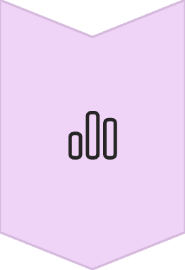
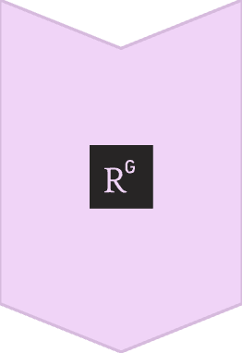
Recommendations & Next Steps
Personalized Interventions
Develop cluster-specific treatment plans. Target highest-impact variables for each patient group.
Predictive Modeling
Build early warning systems. Identify patients shifting toward higher-risk clusters.
Leverage Health Tech & Feedback
Incorporate wearables, IoT data, and patient feedback to make programs responsive and adaptive.
These clustering techniques demonstrate significant potential for healthcare decision support systems. Implementation could improve patient outcomes and resource allocation.
Notes:
We recommend developing targeted wellness interventions based on identified clusters. For instance, patients in a cluster with low exercise and high BMI may benefit from personalized fitness plans, while others with high stress may need mental health support. Over time, re-clustering and wearable data integration can further refine these programs, making them adaptive and patient-centric

Slide 14
Conclusion
Key Findings
Future Directions
Unsupervised clustering revealed actionable patient wellness profiles
Validation
PCA improved metric scores and visualization clarity
Apply methodology to real clinical datasets
K-Means with PCA provided optimal results
Integration
Implement in healthcare decision support systems
Expansion
Include additional wellness metrics for deeper insights
Notes:
To summarize, unsupervised learning—particularly K-Means with PCA—proved effective in segmenting patient wellness profiles. These insights can help healthcare providers tailor wellness programs and allocate resources more efficiently. Future research should explore real clinical datasets and include additional behavioral and biometric variables.

Slide 15
References
Alanazi, A. (2022). Using machine learning for healthcare challenges and opportunities. Informatics in Medicine Unlocked, 30, 100944. https://www.sciencedirect.com/science/article/pii/S2352914822000739 Lu, H., & Uddin, S. (2024). Unsupervised machine learning for disease prediction: A comparative performance analysis using multiple datasets. Health and Technology, 14, 1–19. https://doi.org/10.1007/s12553-023-00805-8
Trezza, A., Visibelli, A., Roncaglia, B., Spiga, O., & Santucci, A. (2024). Unsupervised learning in precision medicine: Unlocking personalized healthcare through AI. Applied Sciences, 14(20), 9305. https://doi.org/10.3390/app14209305

Slide 16
Thank you for your time !

